Slide 1


ADVANCE SYSTEM ANALYS AND DESIGN Presentation BLOOD BANK SYSTEM
Team members (Group 3):
1. Manaswini Reddy Pulakurthi
2. Arshad Jamal
3. Pankaj Kumar

Slide 2
Current Problem
There’s not enough knowledge about blood donation to the general people.
People can’t find near by blood banks.
Procedure and eligibility criteria unknown to most of the people.
Blood banks and Hospitals can’t find volunteers at real-time for the rare blood groups.
People can’t find information about which blood bank has which blood group.

Slide 3
What is Blood Bank System?
Web application
provides Information about Blood donation
provides Eligibility Criteria’s
Data about donors, blood banks, hospitals and blood availability.

Slide 4
Requirements
User specific requirement
Log in options like Facebook, Gmail, and own user account
Advance search option like search blood near me, search by zip code and search by blood group
Volunteer for blood donation
Search Blood banks – currently specific to Tampa
Blood donation general information
Blood donation eligibility criteria
Send Notification – For emergency situations and Blood drives

Slide 5
Non Functional Requirement
Performance
Web based application with a good database connection
Availability
Cloud based application, high availability
Security Requirement
System should not store any passwords of the users
Supported browsers for desktop devices
Google Chrome , Firefox, Internet Explorer
Safari for Mac (version 9 and above)
Supported browsers for mobile devices
Google Chrome
Safari for Mac (version 9 and above)

Slide 6

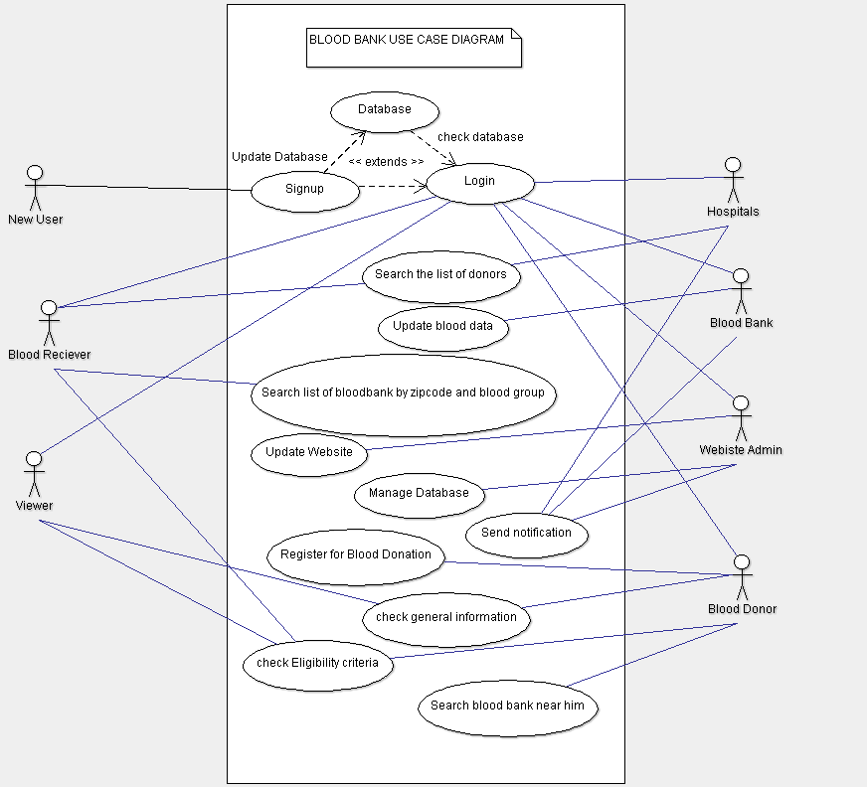
Use Case Diagram

Slide 7
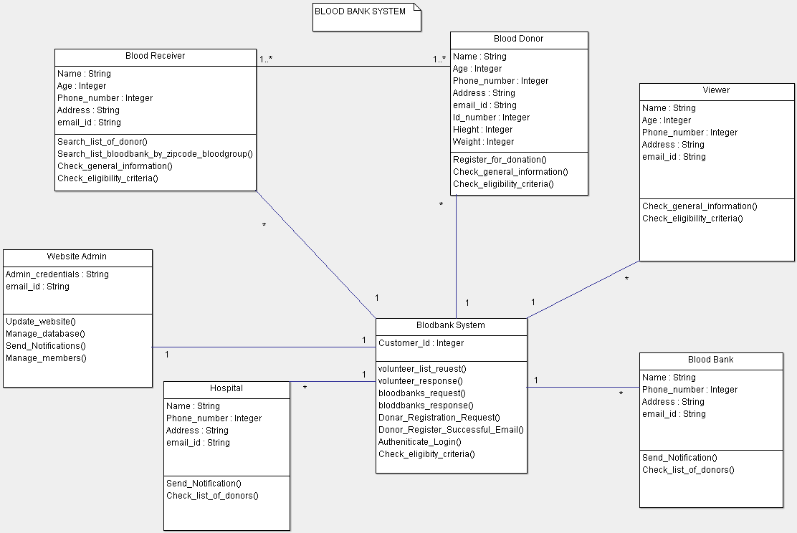
Class Diagram

Slide 8
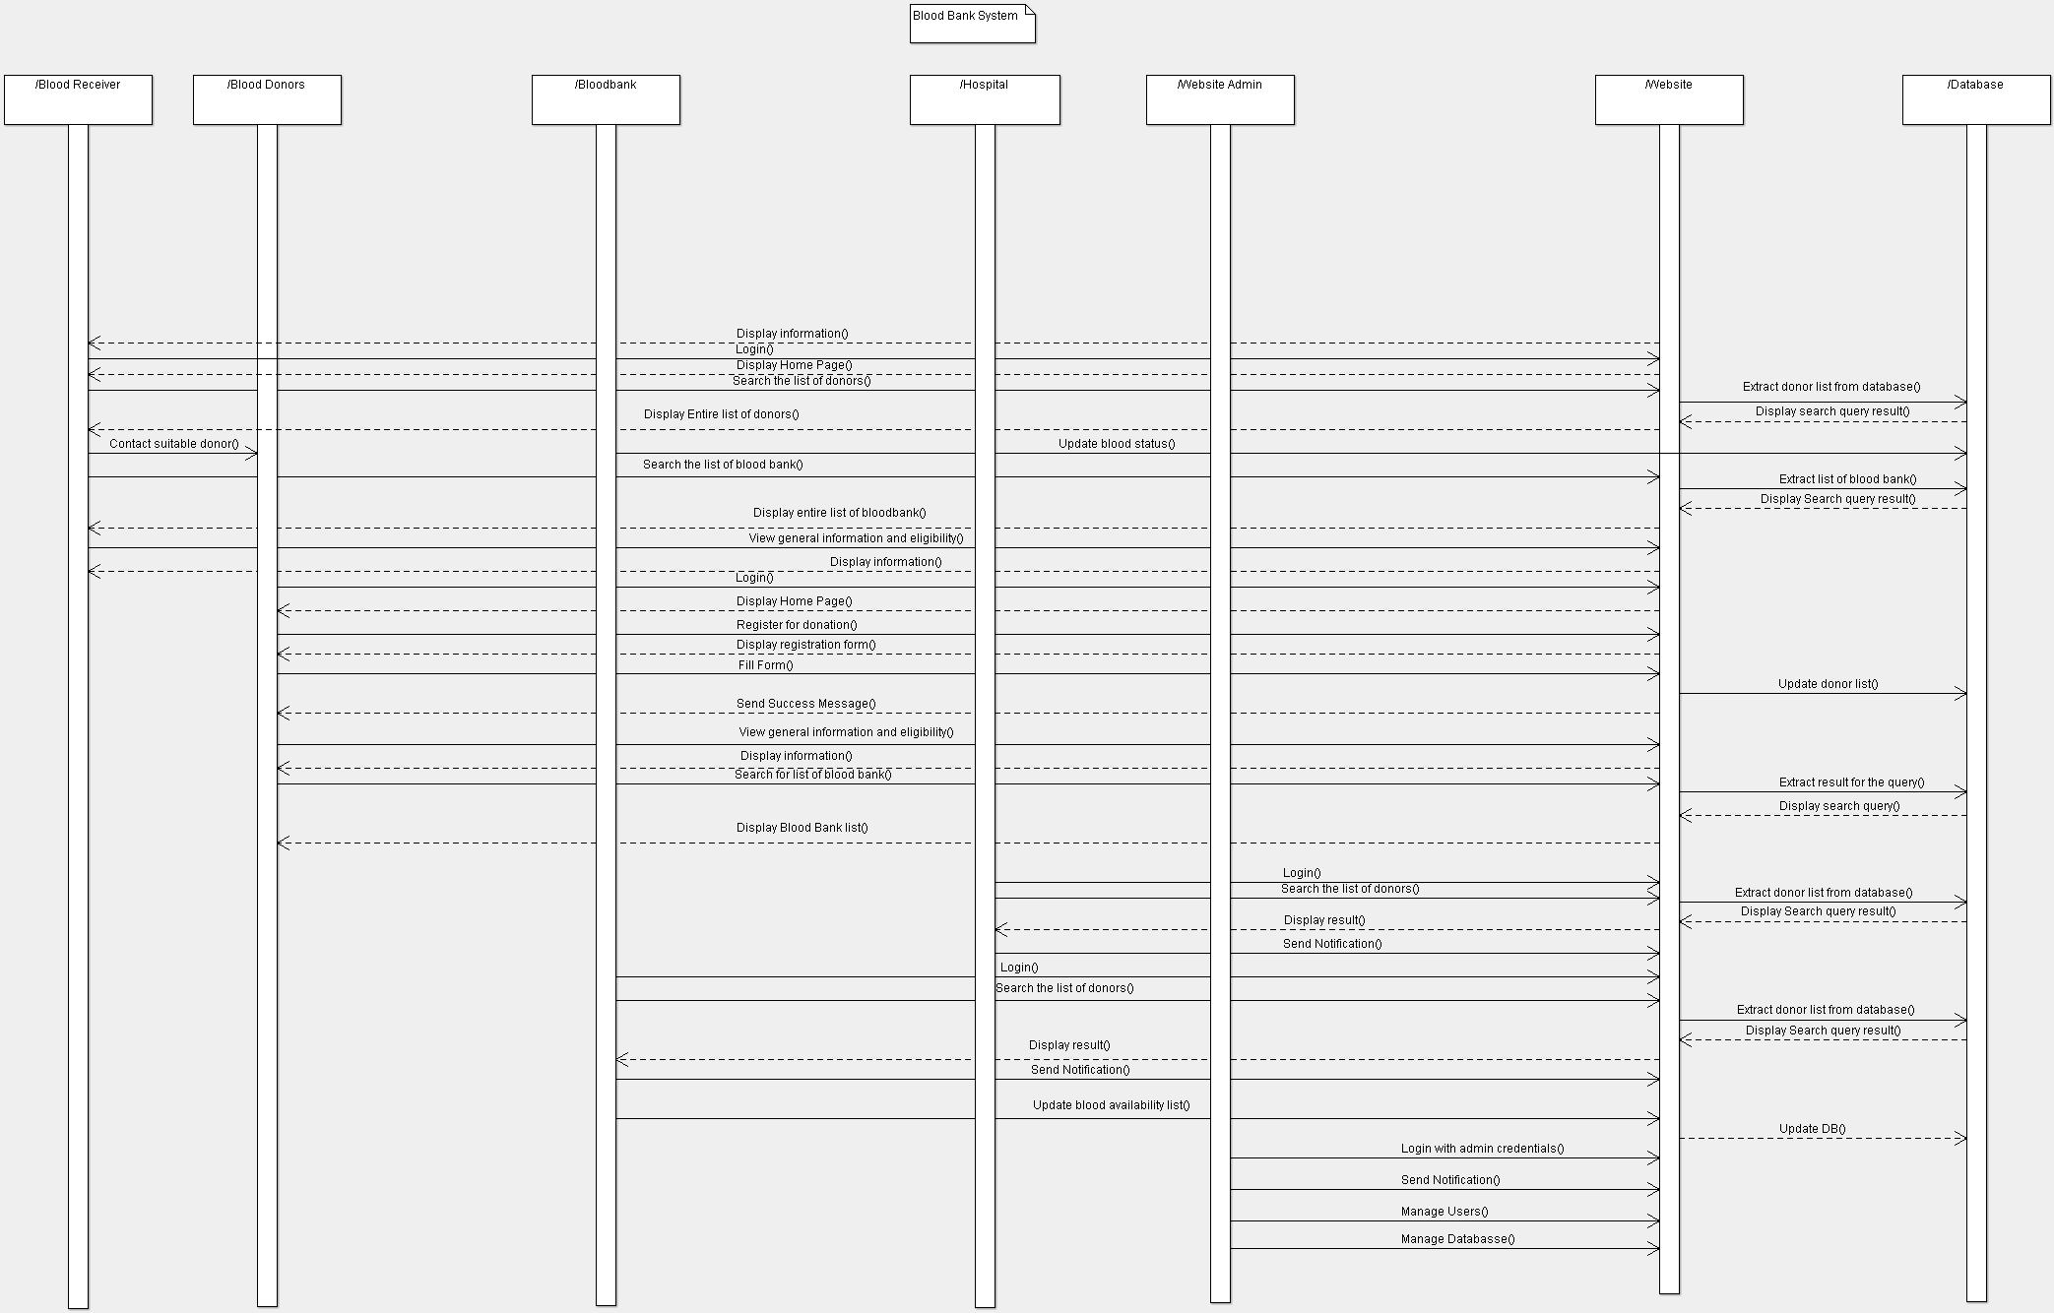
Sequence Diagram

Slide 9
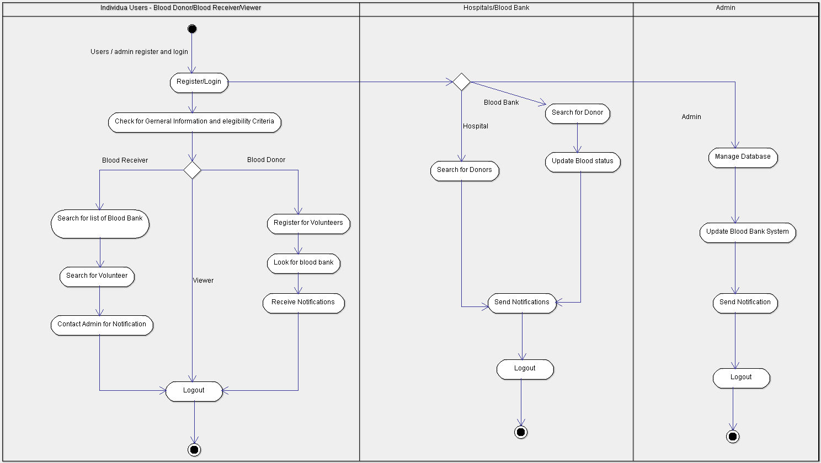
Activity Diagram

Slide 10
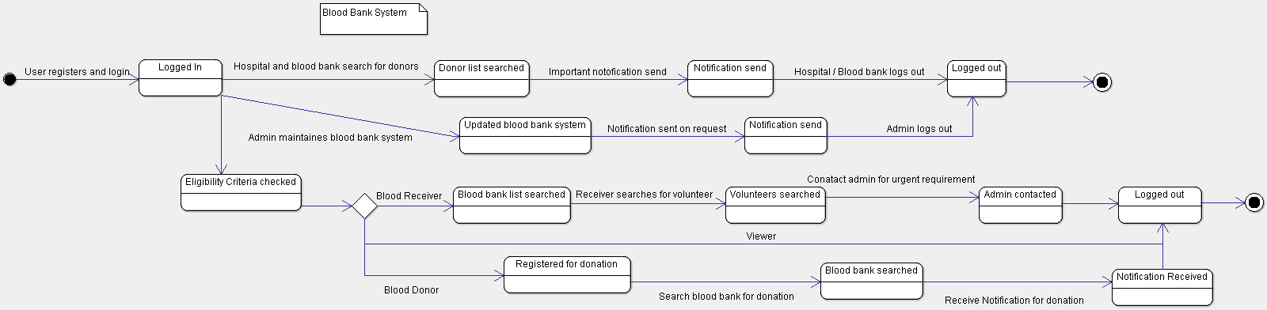
State Diagram

Slide 11
Modules
Blood Donation Registration:
Donor need to register separately for donation
Provide personal detail
Information collected in our database
Search Blood Bank near me:
Provide zip code and distance
Fetches results from database
Provides list of blood bank
Search Volunteers:
Provide zip code, distance and blood group
Fetches results from database
Provides list of donors based on location and blood required
Get Information:
General facts and information
Eligibility conditions and criteria

Slide 12
Implementation
Web Design :
Built on WIX platform
Cloud-Based Development
Used HTML 5, JavaScript and templates
Database Design:
Designed in Caspio
Cloud Database
User Management through Caspio
Tables:
Volunteers Table
Blood Bank Table
User Table

Slide 13
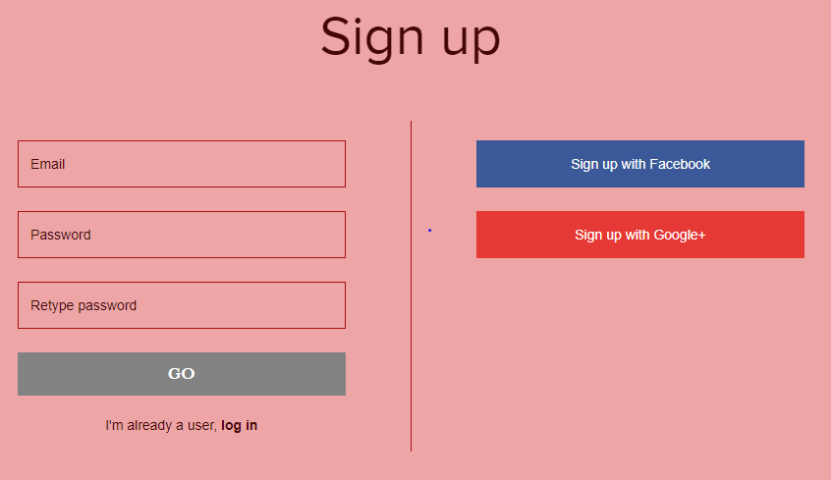
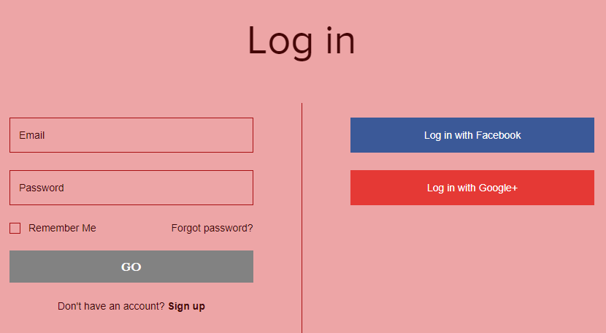
Snapshots
Login / Sign Up
https://manaswinireddy.wixsite.com/bloodbank

Slide 14

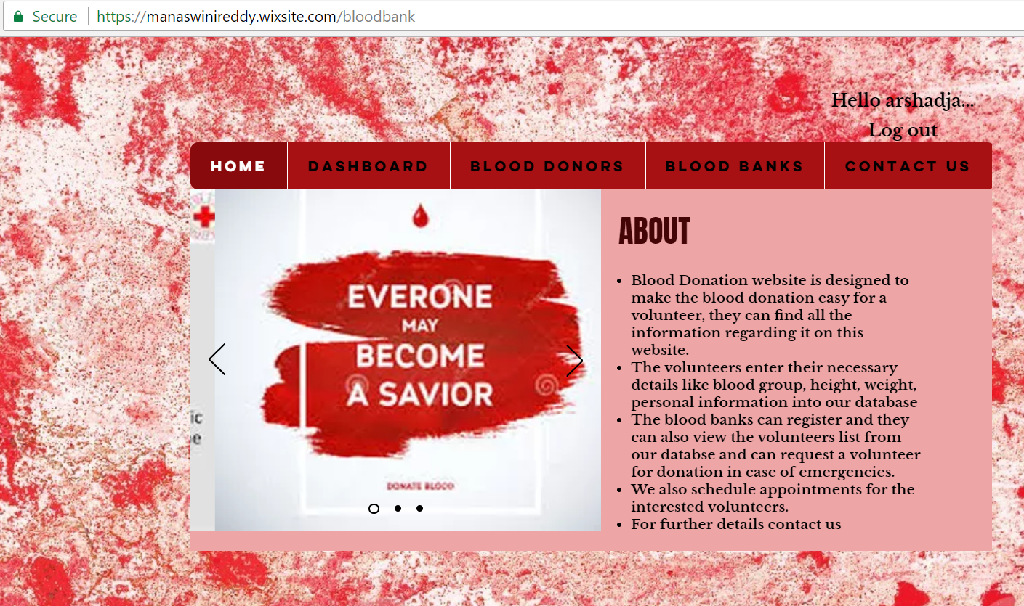
Home Page

Slide 15
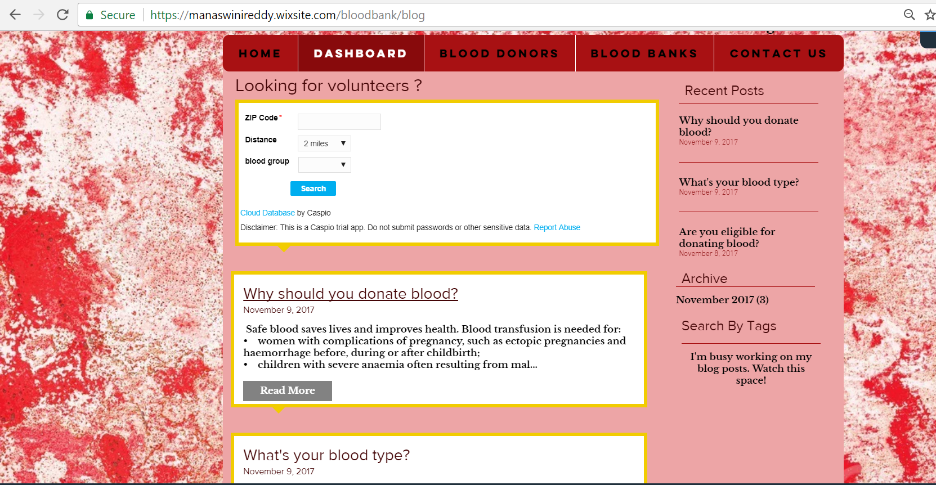
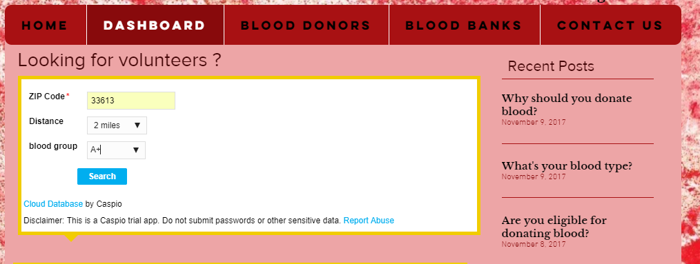
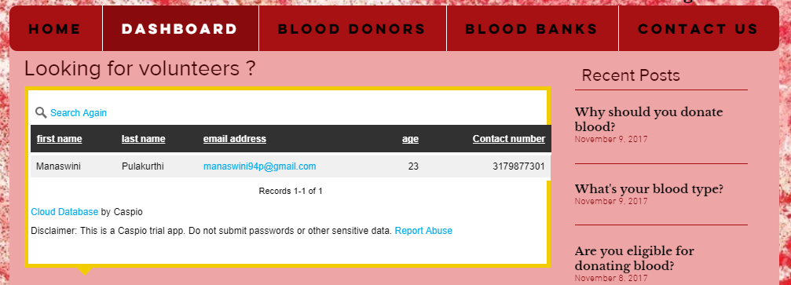
Dashboard

Slide 16
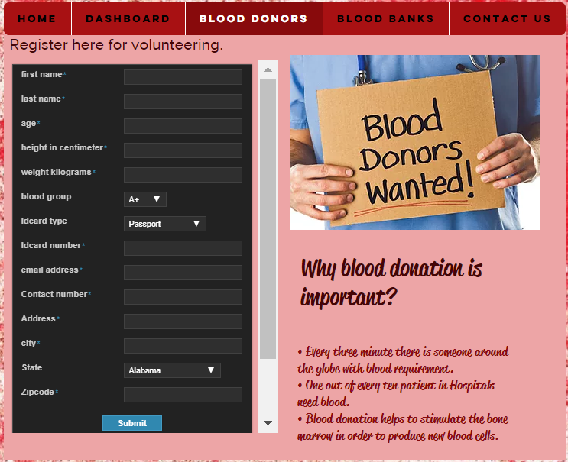
Blood Donors

Slide 17
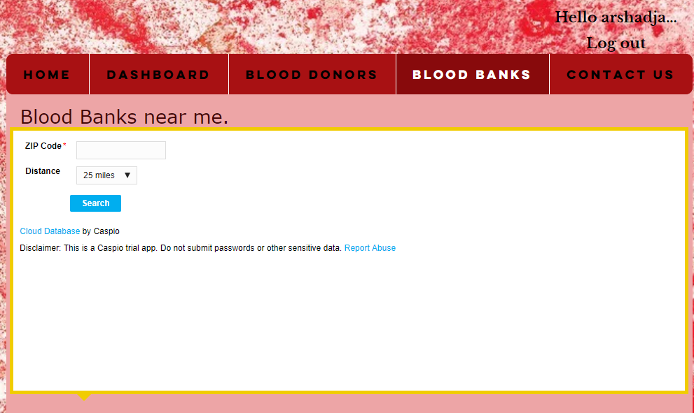
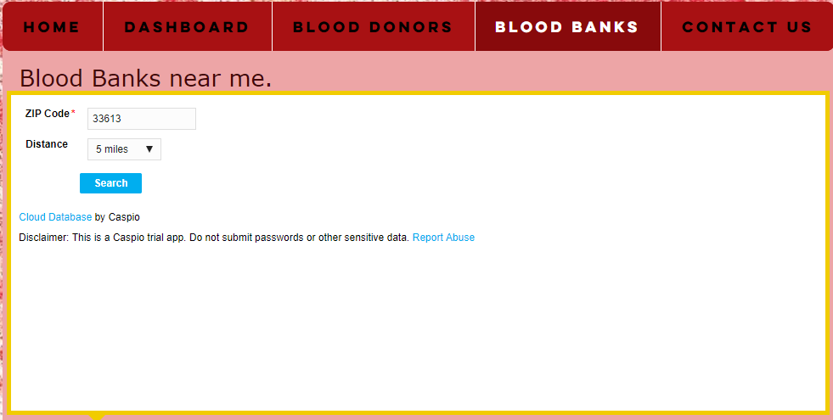
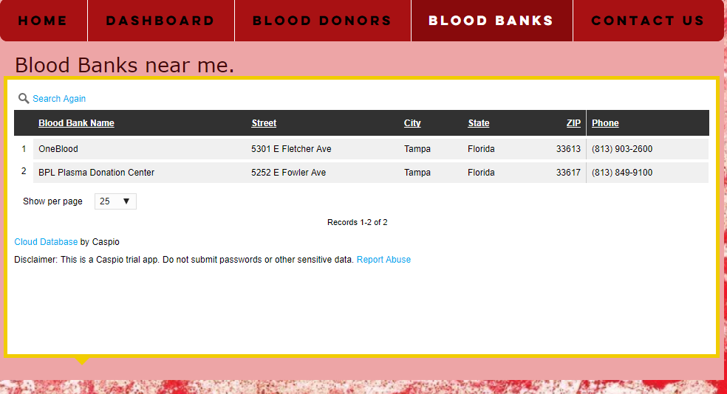
Blood Banks Page

Slide 18
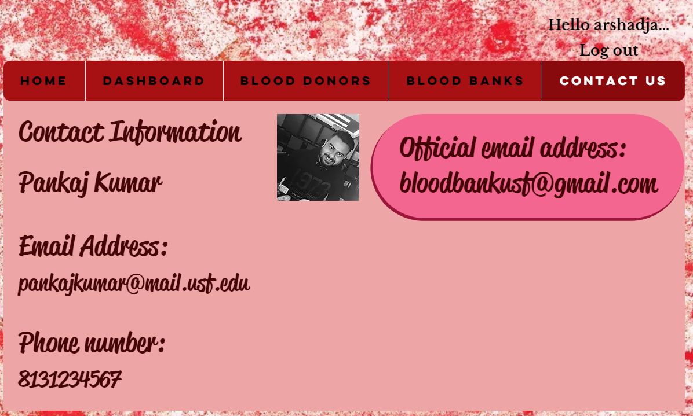
Contact US Page

Slide 19
Testing
Testing during the requirements:
Feasibility of requirements and ensuring key requirements are present.
Testing during design:
Firstly, created a rough design and then after finalizing the requirement, we created final design.
Testing during implementation:
Functionality testing:
This is testing for the links in web pages, submission of forms and getting information from user in web pages.
Usability testing:
Easy navigation, clear instructions and consistency in web pages
Compatibility testing:
Compatibility of the website in different web browsers and mobile browser and their printing option testing in maintenance and enhancement: yet to determine

Slide 20
Future Enhancements
Allow blood banks to enter and update their stats and records which in maintained in database
Cover more states for blood bank data(Only Florida is covered in current system)
Different access levels for blood bank, hospital and individual users.
Include real time chat and messaging facility for interaction between donor and receiver.

Slide 21

Everyone may become a savior…

Slide 22

Suggestions and Feedback !!!

